Slide 1

LINEAR SEARCH
BUBBLE SORT
BINARY SEARCH
PRESENTED
BY
PALURU MOUNIKA

Slide 2
Topics:
INTRODUCTION:
LINEAR SEARCH—Example, Code, Output,
Advantages and Disadvantages
BUBBLE SORT—Exampl, Advantages and
Disadvantages,code,output
BINARY SEARCH--Example, Code, Output,
Advantages and Disadvantages

Slide 3
INTRODUCTION
SEARCHING:
The definition of a search is the process of looking for
Something.

Slide 4
Linear Search
Linear Search involves checking all the
elements of the array (or any other structure) one by one and in sequence until the desired result is found.

Slide 5
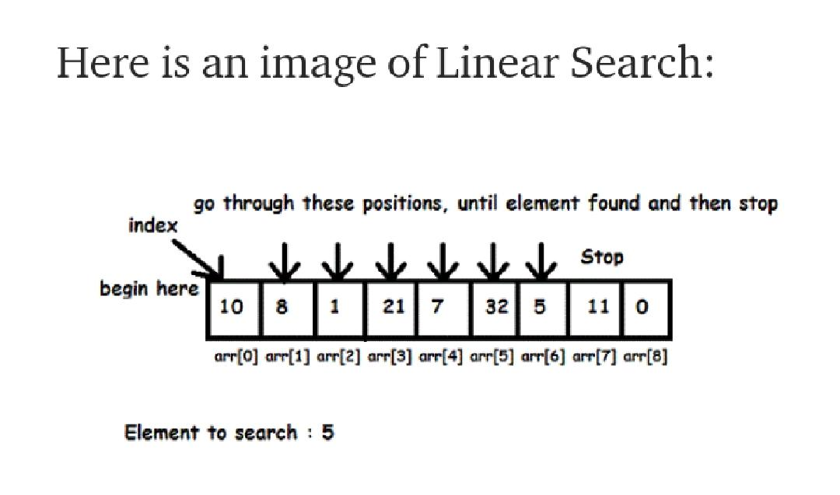
Example

Slide 6
using System;
using System.Collections.Generic;
using System.Linq;
using System.Text;
using System.Threading.Tasks;
namespace linear_search
{
internal class Search
{
static void Main(string[] args)
{
Search search = new Search();
int[] search_list = new int[] { 12, 34, 5, 67, 78, 10 };
int n, res;
Console.WriteLine("Enter a number to search: ");
n = Convert.ToInt32(Console.ReadLine());
res = search.LinearSearch(search_list, n);
if (res > 0)
Console.WriteLine("The target number " + n + " is found at Index " + res);
else
Console.WriteLine("Target Not Found");
Console.ReadLine();
}

Slide 7
int LinearSearch(int[] arr, int target)
{
for (int i = 0; i < arr.Length; i++)
{
if (target == arr[i])
return (i + 1);
}
return -1;
}
}
}

Slide 8
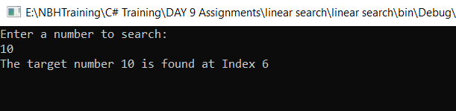
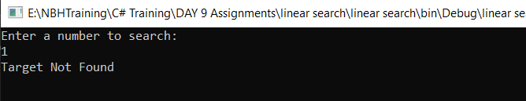
OUTPUT:

Slide 9
Advantages and Disadvantages
Advantages:
Easiest to understand and implement
No sorting required
Suitable for small list sizes
Works fine for small number of elements
Disadvantages:
Time inefficient as compared to other algorithms
Not suitable for large-sized lists
Search time increases with number of elements

Slide 10
Bubble Sort
Bubble sort is a sorting algorithm that works by repeatedly stepping through lists that need to be sorted, comparing each pair of adjacent items and swapping them if they are in the wrong order. This passing procedure is repeated until no swaps are required, indicating that the list is sorted.

Slide 11
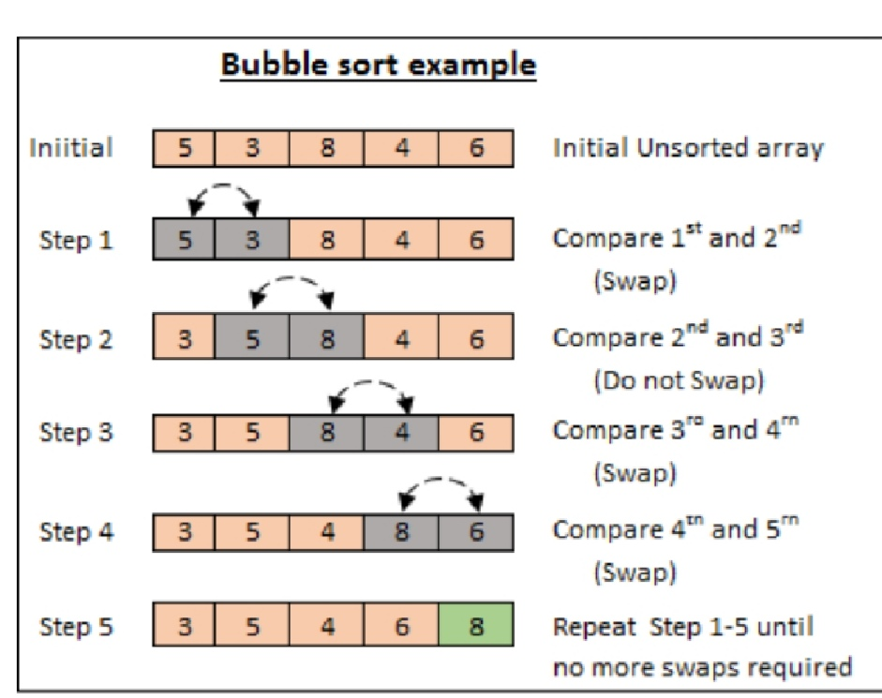
Example:

Slide 12
CODE:
using System;
using System.Collections.Generic;
using System.Linq;
using System.Text;
using System.Threading.Tasks;
namespace BUBBLE_SORT
{
internal class Program
{
static void Main(string[] args)
{
int[] arr = new int[6] { 14, 30, 7, 8, 11, 3 };
bubblesort(arr, 6);
int a;
for (a = 0; a < 6; a++)
Console.Write(arr[a] + "\t");
Console.ReadLine();
}

Slide 13
//bubble sort
static void bubblesort(int[] data, int n)
{
int a;
int b;
for (a = 0; a < n; a++)
for (b = n - 1; b > a; b--)
if (data[b] < data[b - 1])
{
int temp = data[b];
data[b] = data[b - 1];
data[b - 1] = temp;
}
}
}
}

Slide 14
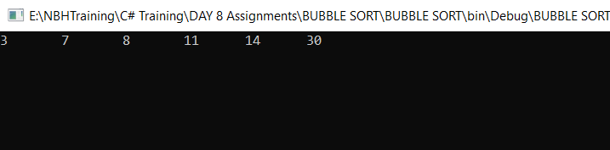
OUTPUT:

Slide 15
Advantages and Disadvantages of
Bubble Sort
Advantages:
Easy to understand.
Easy to implement.
In-place, no external memory is needed.
Performs greatly when the array is almost sorted.
Disadvantages:
The amount of time it takes to sort.
It is highly inefficient for large data sets.

Slide 16
BINARY SEARCH
Binary search is the search technique that works efficiently on sorted lists. Hence, to search an element into some list using the binary search technique, we must ensure that the list is sorted

Slide 17
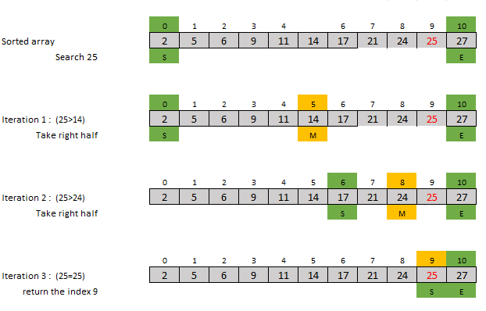
Example:

Slide 18
Advantages and Disadvantages
Advantages :
Faster because doesn’t have to look at every element.
Disadvantages :
Recursive calls are time consuming.
List must be sorted.

Slide 19


